Slide 1


Protecting Sensitive Data: A PII Redaction Solution
Ensuring data privacy and compliance is paramount in today's data-driven world. This presentation outlines our innovative system for detecting, redacting, and evaluating Personally Identifiable Information (PII) in textual data.
Notes:
1

Slide 2
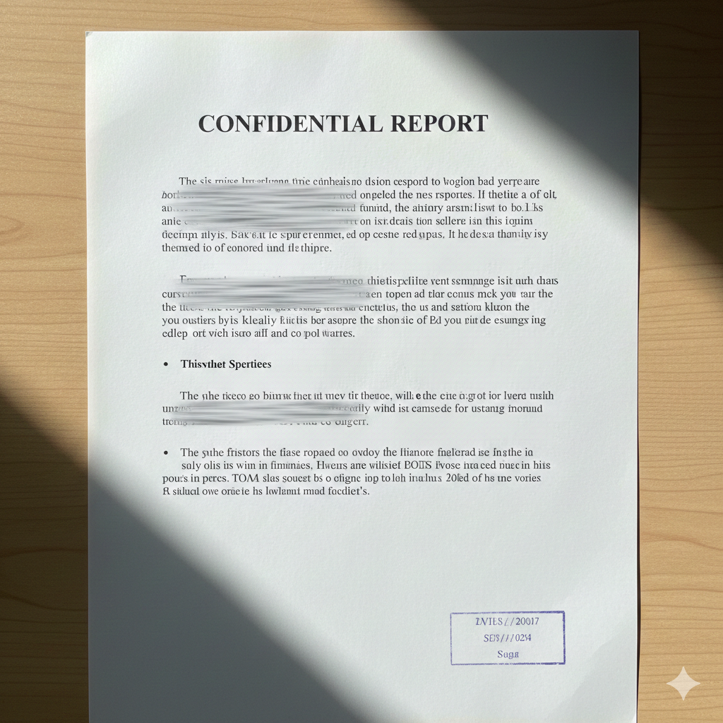

The Critical Need for PII Redaction
Data Proliferation
Compliance & Security
Organizations handle vast amounts of textual data containing sensitive details like names, emails, and financial information.
Protecting this data is critical for privacy, legal mandates (GDPR, HIPAA), and overall data security.
Manual Redaction Challenges
Traditional manual redaction is slow, prone to human error, and impractical for large datasets.
Notes:
2

Slide 3
Our Hybrid Redaction Approach
Our system addresses these challenges with a sophisticated, hybrid approach that combines advanced machine learning with custom rule-based patterns.
Machine Learning
Hybrid Detection
Rule‑Based Patterns
Notes:
3

Slide 4

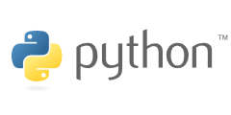
System Architecture: A Python-Based Web Application
Streamlit Web Interface
Efficient Batch Processing
An intuitive Streamlit-based web application provides an easy-to-use interface for interactive PII redaction evaluation.
Streamlit's session state and caching optimize handling for large datasets, enabling previews and real-time metric calculation.
Redaction Engine Core
Powered by Microsoft Presidio, our RedactionEngine detects PII using both machine learning models and custom regex patterns.
Redaction Modes
Supports complete removal or masking of sensitive data with entity labels (e.g., [PERSON], [EMAIL]).
Flexible Input & Output
Users can input single text snippets or upload batch datasets in TXT, JSONL, or ZIP formats.
Notes:
4

Slide 5
Library Table
Library / Package | Used in file | Purpose
streamlit | eval_app.py | Web dashboard (main framework)
pandas | eval_app.py | Display tables, metrics, CSV export
Levenshtein | eval_app.py | Fast Levenshtein distance (similarity calc)
json | both | Parse .jsonl files
zipfile | eval_app.py | Handle .zip uploads
time | eval_app.py | Small delay during engine loading
pathlib | eval_app.py | Clean file name handling (Path)
presidio-analyzer | redactor.py | Detect PII (AnalyzerEngine, Pattern, etc.)
presidio-anonymizer | redactor.py | Redact or mask PII (AnonymizerEngine)
re | redactor.py | Raw regex for custom phone pattern
typing | redactor.py | Type hints (List, Dict, Any)

Slide 6





Hybrid Detection Strategy in Detail
Machine Learning
Custom Regex Patterns
Presidio Analyzer uses pre-trained ML models for general PII (names, addresses, SSNs).
Supplements ML with custom rules for specific formats (e.g., phone numbers) to boost accuracy.
Enhanced Accuracy
Presidio Anonymizer
This hybrid strategy ensures robust and highly accurate PII detection across varied data.
Applies redaction based on selected mode: complete removal or masking with entity labels.
Notes:
5

Slide 7
Navigating Development Challenges
Building this system required overcoming several complex technical hurdles.
1
Performance & Responsiveness
Optimizing Streamlit for large datasets to ensure a smooth, real-time user experience.
2
Evaluation Metrics
Developing precise methods for Levenshtein distance and similarity scores to quantify redaction quality.
3
Overlapping Entities
Accurately detecting multi-line or overlapping entities while maintaining original text structure.
4
Diverse Input Formats
Implementing robust parsing strategies for TXT, JSONL, and ZIP files.
Notes:
6

Slide 8


Quantifying Redaction Effectiveness: Performance Metrics
Our system uses quantitative metrics to objectively measure the accuracy and impact of redaction.
>95%
<5%
100%
Similarity Score
Levenshtein Distance
Entity Detection Rate
Quantifies text preservation after redaction; higher scores indicate minimal alteration.
Measures character-level changes, revealing the extent of text modification.
Ensures completeness by tracking the total number of PII entities identified per document.
For batch evaluations, we provide aggregate metrics like average similarity and average entities per document for comprehensive oversight.
Notes:
7

Slide 9
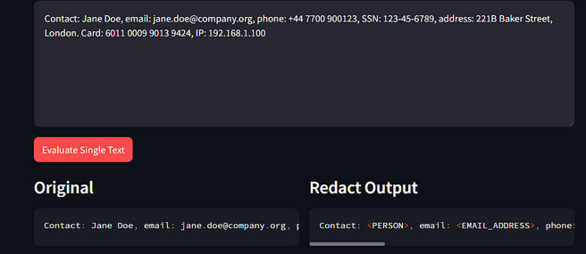
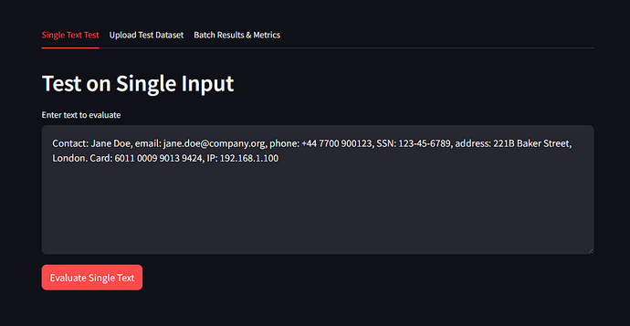
Interactive Demo: Single-Text Redaction
Instant Feedback
Real-time Metrics
Users input text, and the system immediately displays a redacted preview.
Levenshtein distance and similarity scores provide immediate feedback on redaction accuracy.
Detailed Entity Listing
Detected PII entities are listed with their types and precise positions.
Before & After
The interface clearly shows the original text alongside its redacted version.
Notes:
8

Slide 10
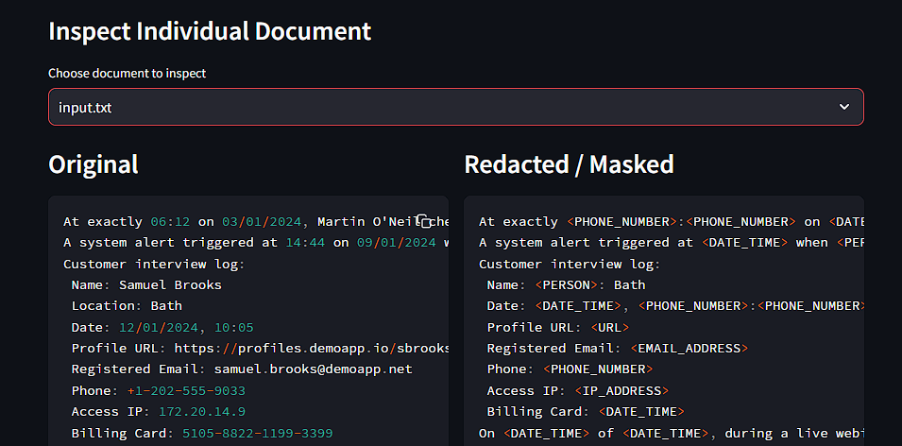
Interactive Demo: Batch Processing & Comprehensive Reporting
Bulk Upload
Aggregate Metrics
Upload multiple documents for simultaneous processing and redaction previews.
View comprehensive performance metrics for the entire dataset.
Review & Commit
Exportable Results
Review individual document redactions and commit the entire batch.
Download committed results as a CSV file for further analysis and sharing.
Notes:
9

Slide 11
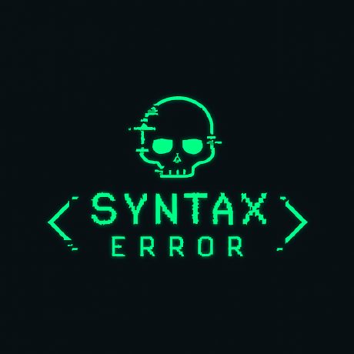
Presented By
Notes:
9

Slide 12
THANK YOU
Notes:
9

